Slide 1


PY-EXPO
2K24
Team ID:
Team Name: Crypto Conquerors
Genius innovation leaves behind a legacy...
PYEXPO 2K24

Slide 2
PS Code: PY132
Problem Statement: PY app’s
Digital Pet Adoption Monitoring System
The growing trend of pet adoption through online and mobile platforms necessitates improving the adoption experience by giving adopters an easy way to monitor and keep track of the welfare of the animals they have acquired. There are ambiguities and worries about the safety of adopted pets as a result of the opaque nature of traditional adoption procedures and the lack of instantaneous connection between adopters and shelters. Thus, the task is to provide a Python-based solution that makes use of contemporary technology to enable pet adoption through a mobile application or web platform, allowing adopters to remotely monitor and stay updated on their adopted animals. Creating a Python-based application that improves the pet adoption process by giving adopters a digital platform to monitor and get information on the welfare of their new pets is the goal of this hackathon competition. The program ought to facilitate smooth correspondence between adopters and shelters, cultivating openness and confidence in the adoption procedure.
02
PYEXPO 2K24

Slide 3
Introduction :
Imagine a world where finding the perfect furry companion is not only easy but also deeply fulfilling for both you and the pet.
we connect with animals in need of homes
Introducing our innovative pet adaptation web, designed to match potential adopters with their ideal pets for both the pet and their new family
Technology used :
HTML: It’s the foundation of all web pages. It creates the structure and content of a site
CSS: This is what makes websites look good. It styles the HTML with colors, layouts
Flask: A lightweight Python framework for web development. It’s used to make web apps quickly and with less code3.
Kivy framework: A Python library for developing multitouch applications
03
PYEXPO 2K24

Slide 4

Service We Provided
Buying and selling
Training tutorial
Pet match making
Take care center
shop location
Doctor consultation
Career opportunity
Figure 2: header logo for Pet Adoption System
04
PYEXPO 2K24

Slide 5
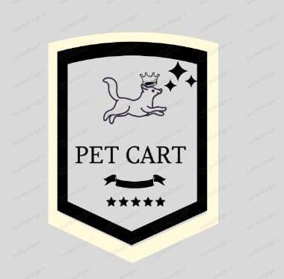
SWOT ANALYSIS:
Strengths :
Do multiple work on the single platform
Doctor consultation
Navigating the costumer to take care center
Providing tutorial video for pet training
Providing best breed pet making
Weakness:
People requirement at starting .
Financial troubles
Market Saturation: New businesses entering the industry face challenges due to oversaturation and intense competition
Negative Attitudes: Negative perceptions of pet ownership may impact the industry’s reputation.
Figure 1: creative logo for Pet Adoption System

Slide 6
Opportunities:
Animal Welfare Focus: Collaborating with adoption centers can help more pets find homes.
Eco-Friendly Practices: Incorporating sustainable practices promotes environmental responsibility.
Telemedicine Integration: Leveraging web technology for doctor consultations can enhance pet care.
career opportunities in deliver and pet take care and pet breeding platform
Threats:
Market Volatility: Economic fluctuations and changing consumer preferences can affect the industry.
Regulatory Challenges: Compliance with evolving regulations related to pet care and health.
Health Concerns: Outbreaks, diseases, and health risks impact pet adoption and monitoring systems
05
PYEXPO 2K24

Slide 7

Thank You
Any Queries?
PYEXPO 2K24

